Slide 1

Dr.seq2
[General]
——Parameters in config file

Slide 2
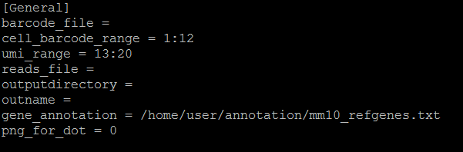
Parameters in [General]

Slide 3
Parameters in [General]
barcode_file =
# Fastq file only, by default, every barcode in fastq file consist of 20 bp including 12bp cell barcode(1-12bp) and 8bp UMI(13-20bp).
Note that cell barcode should locate before UMI

Slide 4
Parameters in [General]
cell_barcode_range = 1:12
umi_range = 13:20
# Location of cell barcode and UMI,. by default they are 1:12 and 13:20.
For example:
If the barcode in your fastq is AAAAAAAAAAAACCCCCCCC,then the cell_barcode of this reads is A 1:12 and the UMI is C 13:20

Slide 5
Parameters in [General]
reads_file =
# Accept raw sequencing file (fastq) or aligned file(sam), file type is specified by extension.
outputdirectory =
#Directory for all result. default is current dir "." if user left it blank , but not recommended.
outname =
#Name of all your output results, your results will looks like outname.pdf, outname.txt

Slide 6
Parameters in [General]
gene_annotation =
# Gene model in full text format, download from UCSC genome browser.
png_for_dot = 0
#Only works for dotplots in individual cell QC. set 1 to plot dotplots in individual cell QC in png format, otherwise they will be plotted in pdf format.

